Slide 1
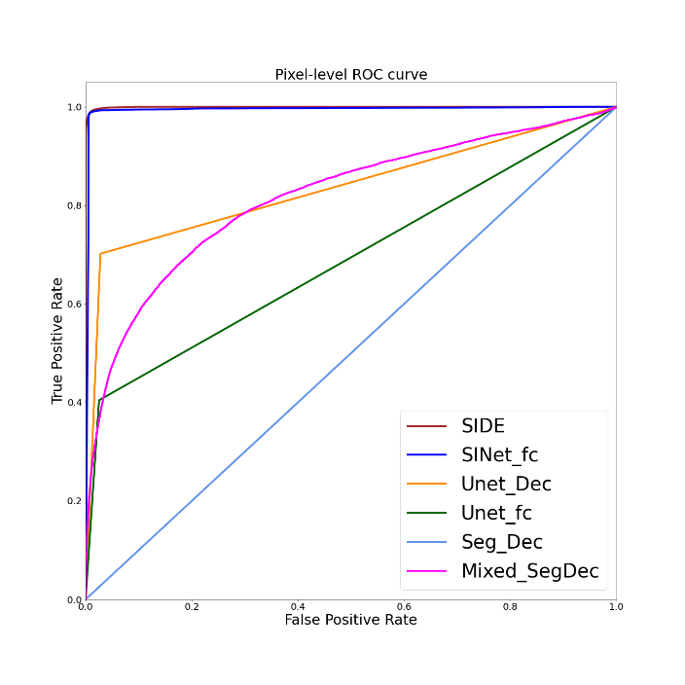
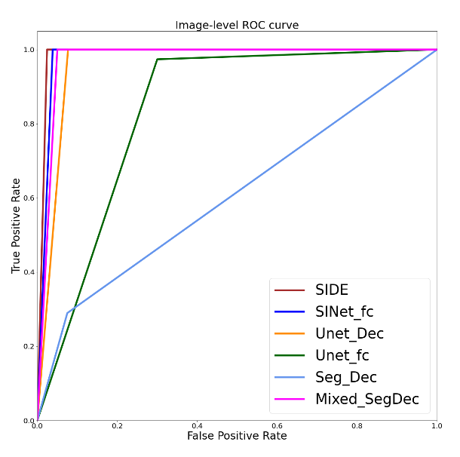
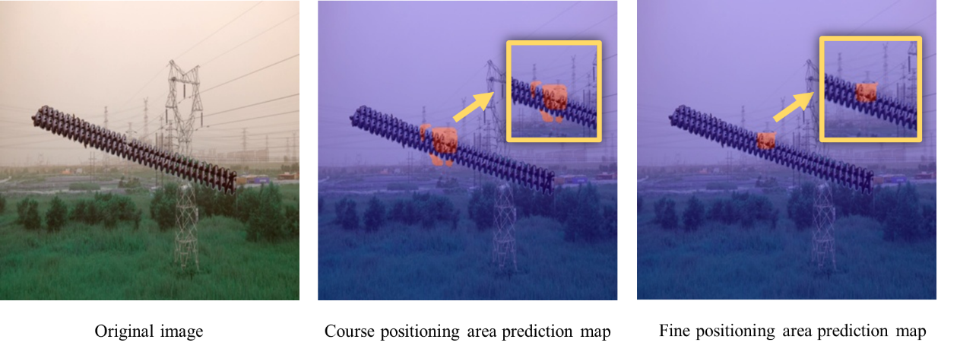
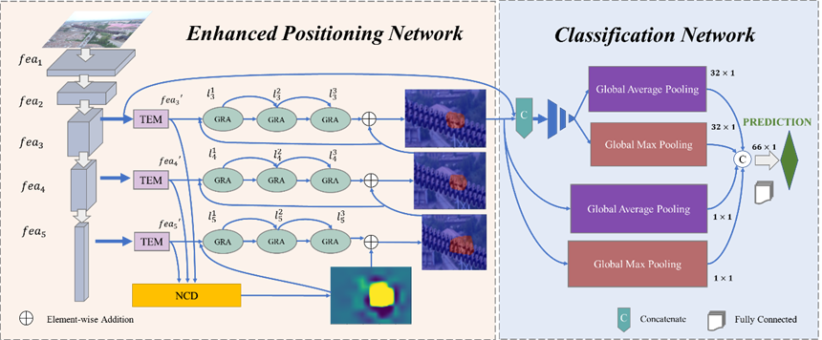
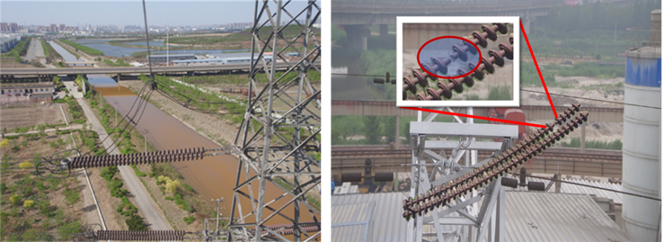
2024 4th International Conference on
Education, Language and Art (ICELA 2024)
Insulator Defect Detection: A Detection Method of Target Search and Cascade Recognition
YU Jinyunª, LIU Kaipeiª, HE Min^{b}, QIN Liangª
a. School of electrical and automation, Wuhan University, Wuhan 430072,China
b. School of electronic and electrical engineering, Wuhan Textile University, Wuhan 430200, China
INTRODUCTION
Model Comparison
Insulators serve as an indispensable part of power transmission. Due to long-term exposure outdoors, insulators are prone to failures such as broken string failure. According to the relevant data, the accidents caused by insulator failures exceed half of the grid failures each year. Therefore, it is quite necessary to maintain and overhaul insulators. Traditional inspection methods mostly rely on manual detection, which is inefficient and highly dangerous. Recently, research on identifying defective insulators through UAV power inspection and deep learning has attracted much attention.
Table 1 Comparison of evaluation indicators of different models
Model | AUC | IoU | accuracy | F1-score | precision | recall | FPS
UNet_Dec | 0.8369 | 0.050 | 0.9487 | 0.9487 | 0.9524 | 0.9500 | 0.032
UNet_fc | 0.6895 | 0.0342 | 0.8333 | 0.8311 | 0.8603 | 0.8368 | 0.0317
Seg_Dec | 0.5000 | 0.0 | 0.6410 | 0.6253 | 0.6597 | 0.6362 | 0.0535
Mixed_SegDec | 0.8168 | 0.0450 | 0.9744 | 0.9744 | 0.9750 | 0.9750 | 0.0394
SINet_fc | 0.9973 | 0.7247 | 0.9800 | 0.9790 | 0.9790 | 0.9790 | 0.0372
SIDE | 0.9996 | 0.7462 | 0.9899 | 0.9894 | 0.9918 | 0.9872 | 0.0374
PROBLEMS
1) At present, most of the cutting-edge research methods rely on a large number of insulator image data as training samples, while the actual defect data of insulators in actual engineering is very rare and difficult to obtain. How to construct a high-precision and robust detection model in the case of small samples is a key issue to be solved urgently.
2) Aerial insulator images have problems such as large differences in insulator scales and complex backgrounds, resulting in unobvious defect characteristics. How to strengthen the feature extraction ability of the detection network so that it can distinguish the subtle differences in the image, thereby more effectively segmenting the target and background, is a difficult problem.
Fig. 3 Pixel-level ROC curves for the location task and image-level ROC curves for the classification task
METHODS
Process Visualization
The inputted original aerial image is first searched and purified with the help of the defect location network to extract the refined defect segmentation area. Then, it goes through the classification decision network to complete the detection and identification of the insulator broken string defect.
Fig.3 The process of searching and purification
CONCLUSIONS
A. This paper proposes an insulator broken string defect detection method based on target search and cascade recognition. It not only adapts to small sample training scenarios but also maintains excellent defect segmentation ability and high resolution when faced with the dilemma of inconsistent sizes and complex backgrounds.
B. The experimental result indicates that our model has a pixel-level AUC value of 99.96% and an image-level F1-score value of 98.94% for the detection of insulator string breakage defects, which performs better than those existing mainstream models, and achieves ultra-high-precision detection for both positioning and identification tasks.
C. To further improve the generalization ability and recognition breadth of the model, our next step is to consider collecting more samples of different types and structures of insulator defects for training, and then optimize the model in a targeted manner. It is expected to expand the scope of application and enhance its versatility and practicability.
Fig.1 The proposed technical solution for defect detection and identification
Classification decision network
Enhanced positioning network
Texture Enhancement Module
Neighbor Connection Decoder
Grouped Reverse Attention
Global Average Pooling
Global Max Pooling
5 × 5 size convolution
RESULTS
Insulator data set
ACKNOWLEDGEMENT
Fig. 2 Aerial images of normal(left) and defective(right) insulators
This work was supported in part by the National Key Research and Development Program of China with Grant No.2020YFB0905900.

