Slide 1

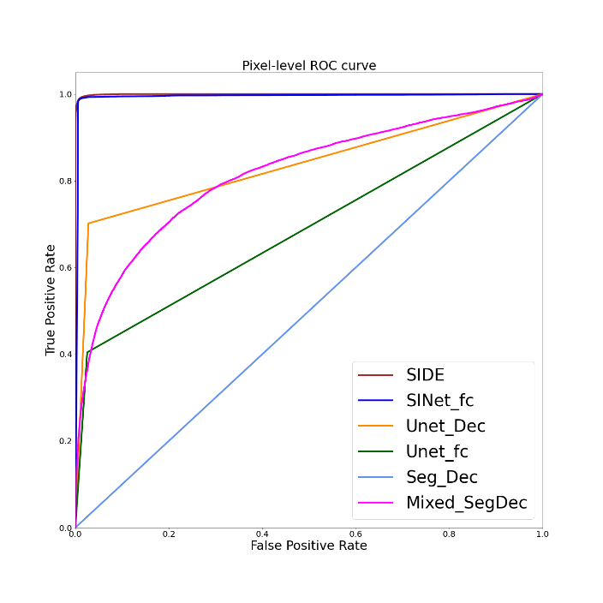
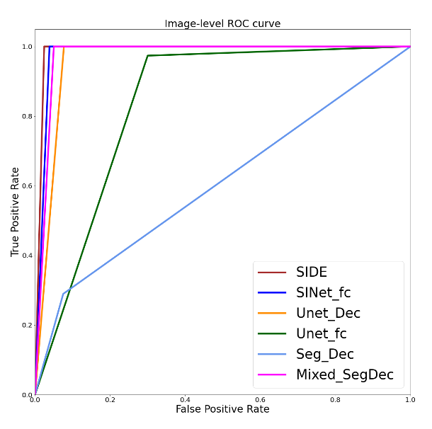
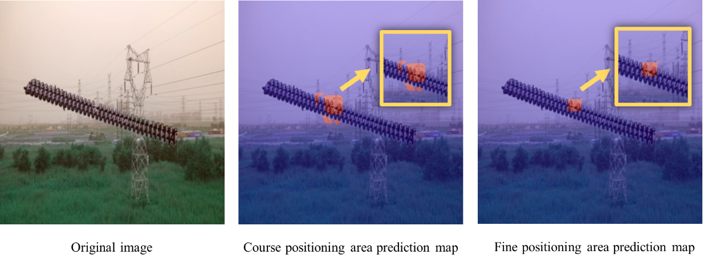
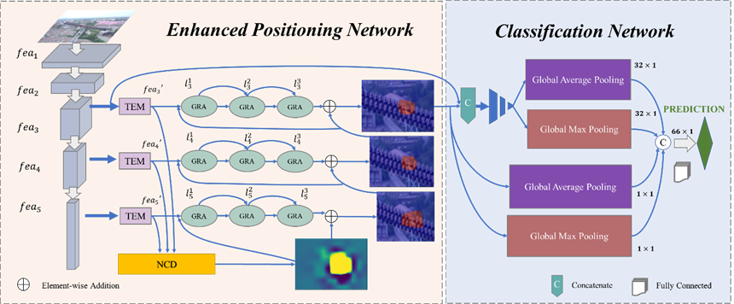
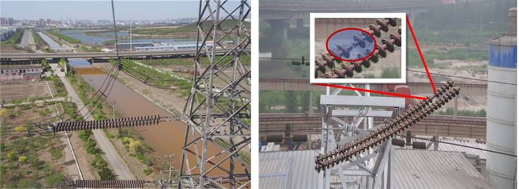
2024 6th International Conference on Robotics, Intelligent Control and Artificial Intelligence (RICAI 2024)
Title: XXXXXXXXXXXXXXXXXXXXXXXXX
XXª, XXXª, XXX^{b},
a. School of electrical and automation, Wuhan University, Wuhan 430072,China
b. School of electronic and electrical engineering, Wuhan Textile University, Wuhan 430200, China
INTRODUCTION
XXXXXXXXXXXXXXXXXXXXXXXXXXXXXXXX.
Table 1XXXXXXXXXXXX
Model | AUC | IoU | accuracy | F1-score | precision | recall | FPS
PROBLEMS
XXXXXXXXXXXXXXXXXXXXXXXXXXXXXXXXX.
Fig. 3 XXXXXXXXXXXXXXXXXXXXXXXXXXXXXXXXXXXXXXXXXXXXXXXX
METHODS
Process Visualization
XXXXXXXXXXXXXXXXXXXXXXXXXXXXXXXXX.
Fig.XXXXXXXXXX
CONCLUSIONS
XXXXXXXXXXXXXXXXXXXXXXXXXXXXXXXXX.
Fig.1 XXXXXXXXXXXXXXX
XXXXXXXXXXXXXXXXXXXXXXXXXXXXXXX.
RESULTS
XXXXX
ACKNOWLEDGEMENT
Fig. 2 XXXXX
XXXXXXXXXXXXXXXXXXXXXXXXXXXXXXXXX.

Slide 2
备注
尺寸及内容：
海报为A1尺寸，模板如上所示，具体请根据论文实际情况调整，格式内容均无定式。
导出及上传：
编辑好海报内容后，请①删除本页备注，②导出第一页幻灯片为图片格式（PNG或JPG）后上传到参会报名系统附件【无需压缩！】，或直接通过微信发给对接的会务组老师。

